Slide 1
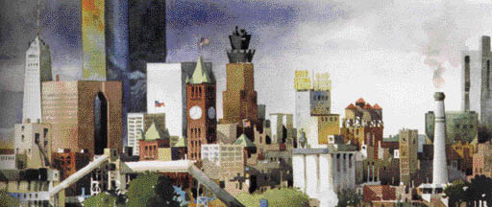

PowerPoint® Lecture Presentation
to accompany
Principles of Economics, Third Edition
N. Gregory Mankiw
Prepared by Mark P. Karscig, Central Missouri State University.

Slide 2
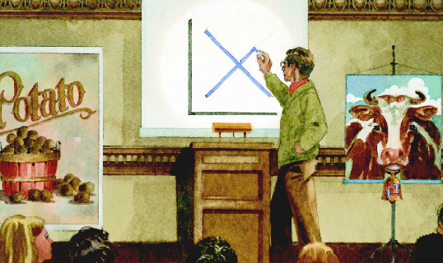
1
INTRODUCTION

Slide 3
1
Ten Principles of Economics

Slide 4
Economy. . .
. . . The word economy comes from a Greek word for “one who manages a household.”

Slide 5
TEN PRINCIPLES OF ECONOMICS
A household and an economy
face many decisions:
  Who will work?
  What goods and how many of them should be produced?
  What resources should be used in production?
  At what price should the goods be sold?

Slide 6
TEN PRINCIPLES OF ECONOMICS
Society and Scarce Resources:
  The management of society’s resources is important because resources are scarce.
  Scarcity. . . means that society has limited resources and therefore cannot produce all the goods and services people wish to have.

Slide 7
TEN PRINCIPLES OF ECONOMICS
Economics is the study of how society manages its scarce resources.

Slide 8
TEN PRINCIPLES OF ECONOMICS
How people make decisions.
  People face tradeoffs.
  The cost of something is what you give up to get it.
  Rational people think at the margin.
  People respond to incentives.

Slide 9
TEN PRINCIPLES OF ECONOMICS
How people interact with each other.
  Trade can make everyone better off.
  Markets are usually a good way to organize economic activity.
  Governments can sometimes improve economic outcomes.

Slide 10
TEN PRINCIPLES OF ECONOMICS
The forces and trends that affect how the economy as a whole works.
  The standard of living depends on a country’s production.
  Prices rise when the government prints too much money.
  Society faces a short-run tradeoff between inflation and unemployment.

